Slide 1
Character:
The Foundation of Leadership
Dr. Sean T. Hannah
Professor of management and Wilson Chair of business
School of Business
Wake Forest University
Colonel, US army (Retired)

Slide 2
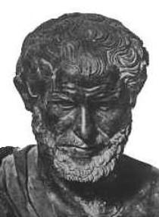
Remember from last class…
Character/integrity (Ethos)
Benevolence/caring (Pathos)
Competence
(Logos)

Slide 3
Roles of Ethical Leaders
Role model
Standard bearer – accountability
Owner of the ethos
Teacher & inspirer of the values
Source of moral resilience when the team is ethically drifting

Slide 4

Ethics in Tough Calls - 3 “Ethical Lenses”
What are the rules, laws, duties, norms, etc. that apply to the dilemma and possible courses of action (COA)? Whose rights are at stake?
RULES/
RIGHTS
OUTCOMES/
CONSEQUENCES
What are the outcomes likely from the various COAs? Which is the most acceptable, benefits the most, harms the least?
How well do the various COA’s align with your personal values and beliefs?
VIRTUES/
INTEGRITY
Notes:
We call the three perspectives described by FM 6-22 “Ethical Lenses”.
Rules are those specifications that a group or groups agree to follow – laws, treaties, professional ethic, etc.
Outcomes are the foreseeable results of action/behavior.
Virtues are those components of “moral and good” human beings that transcend most cultural differences between civilized societies. Many Ethicists consider virtues to be the basis for other constructs like values and morals. Many times all these terms are used interchangeably.
We peer through various lenses to address the different aspects of a event or problem.
In general because of the way our brains work, we tend to solve problems in ways that are quick and/or have worked for us before.
We may not always look for a rule/regulation/professional norm that defines the solution, or consider the factors to produce the best outcome, or compare our personal virtues learning from similar situations.
Note that it is important to “look” through all these lenses to ensure all aspects in the Ethical Situation are considered.
Leaders use multiple perspectives to think about ethical conflicts, applying all three perspectives to determine the most ethical solution.
Applying all three Ethical lenses considering virtue, rules, and outcomes to each Course of Action is called “Ethical Reasoning”.

Slide 5
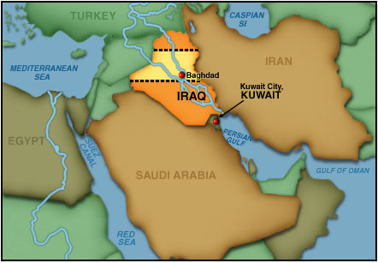
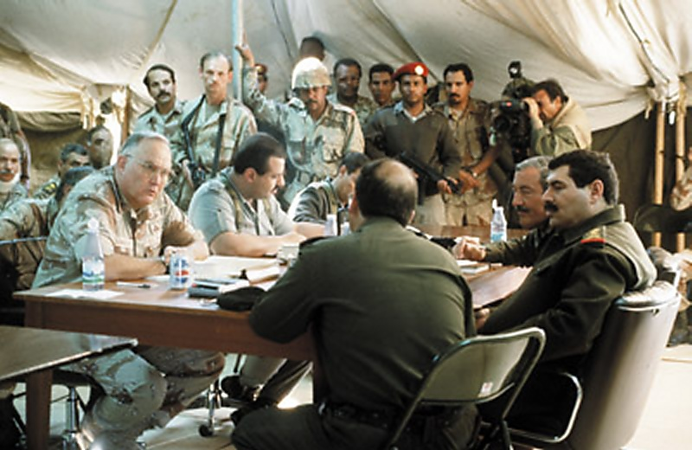
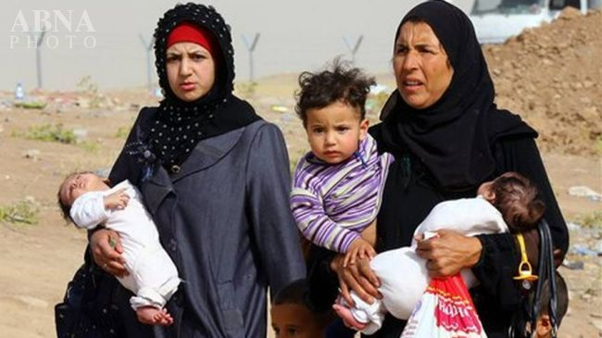
A Dilemma

Slide 6
Dealing with Defining Moments (Right v. Right)
Defining moments reveal, test, and shape you and the team
Reveal your and/or the organization’s basic values
Test the strength of commitments - values hierarchy
Shape the life story and character of you and/or the organization
Character is formed through habits (Aristotle)

Slide 7
Group Discussion
What defining moments have you encountered as team captains?
What lessons did you learn?

Slide 8
Moral Potency
MORAL OWNERSHIP
The extent an individual feels a sense of psychological responsibility over the ethical nature of their own actions, those of others around them, and their organization
MORAL COURAGE
The fortitude to overcome fear and act despite danger or pressures from either inside or outside of the organization to do otherwise
MORAL CONFIDENCE
Confidence in the capability to act to reach a moral goal, while persisting in the face of moral adversity
Hannah & Avolio (2010)
A survey assessment is in your packet

Slide 9
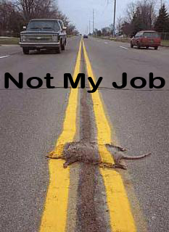

Slide 10
Group Discussion
How can you use your moral potency to hold each other and teammates accountable?

Slide 11
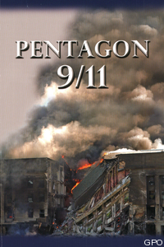
Resource
Services-
Washington
84% KIA

Slide 12
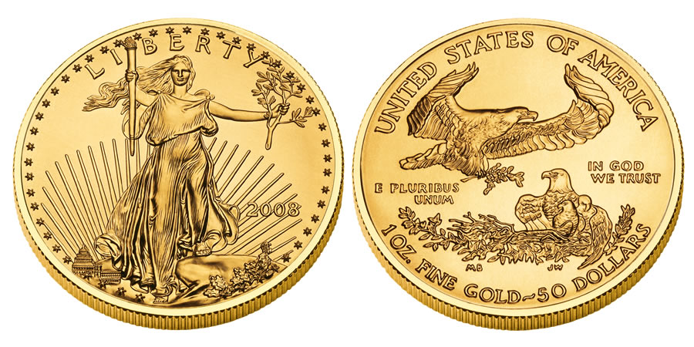
Two Sides of the Same Coin
RESPECT
VALUES
HONOR
& DUTY
We choose to honor and be dutiful to
those things that we respect & value

Slide 13
Group Discussion
What key things can you do as captains to teach and reinforce respect and values in the team?

Slide 14
Recommended Self Reflection Work:
Fill out the…
  Moral Potency Questionnaire
  Values Clarification Exercise
  Ethical Leadership Questionnaire
Reflect on your results and how they influence your behavior as a team captain
Consider in what ways you should change your behavior – what should you start, stop, continue doing as a team captain?

