Slide 1
Leader Influence,
Power, & Motivation
Dr. Sean T. Hannah
Professor of management and Endowed Wilson Chair, School of Business
Wake Forest University
Colonel, US army (Ret)

Slide 2
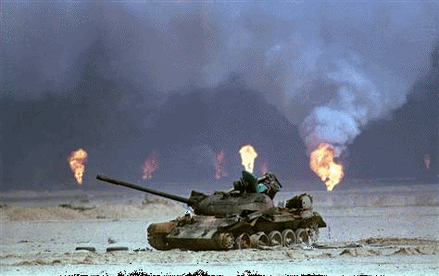
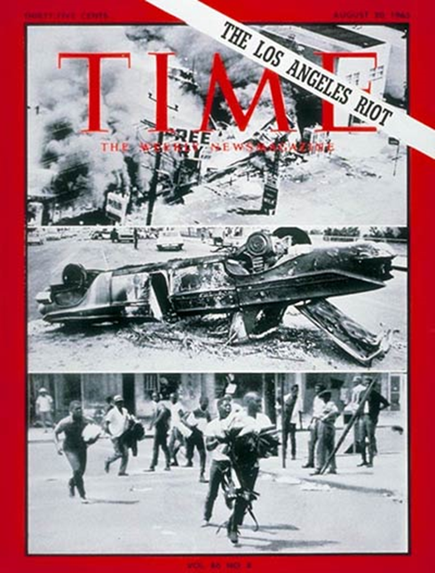
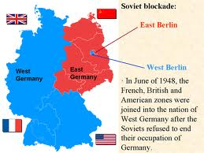



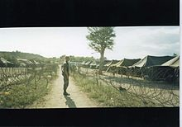


Desert Storm 1990
LA Riots 1992
Cold War 1987-1990
Joint Task Force 160
Panama/Cuba 1994
West Point
2005-12
WFU 2012-

Slide 3
Group Exercise
Describe What in Your
Group’s Mind Constitutes
Great Leadership

Slide 4
BE
Values
Beliefs
Motives
Philosophies
Self-Aware
SHAPE
ACHIEVE &
DEVELOP
Others’
Thoughts
Motives
Behaviors
DO
Leadership Styles
Decisions
Strategies
KNOW
KSAs
Experience
Wisdom
Talents
The Context

Slide 5
Group Exercise Part II
Now, take your group’s list and code each item:
BE
KNOW
DO
SHAPE
ACHEIVE

Slide 6
Leadership
The process of influencing people by providing purpose, direction, and motivation to accomplish the mission and improve the organization
Formal and Informal Leadership
Followership
Shared Leadership
“Leader”: Anyone who can do the above well

Slide 7
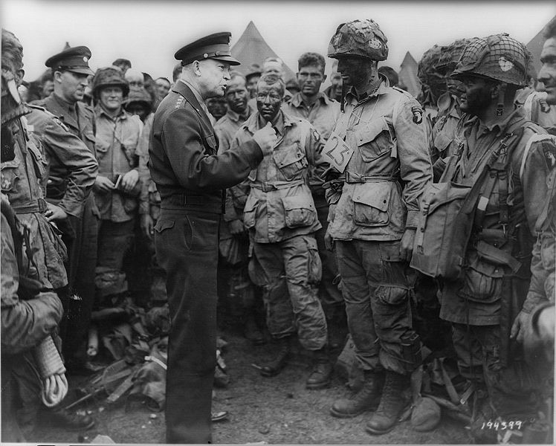
“Leadership is the art of getting someone else to do Something you want done
because he wants to do it” Gen Eisenhower

Slide 8
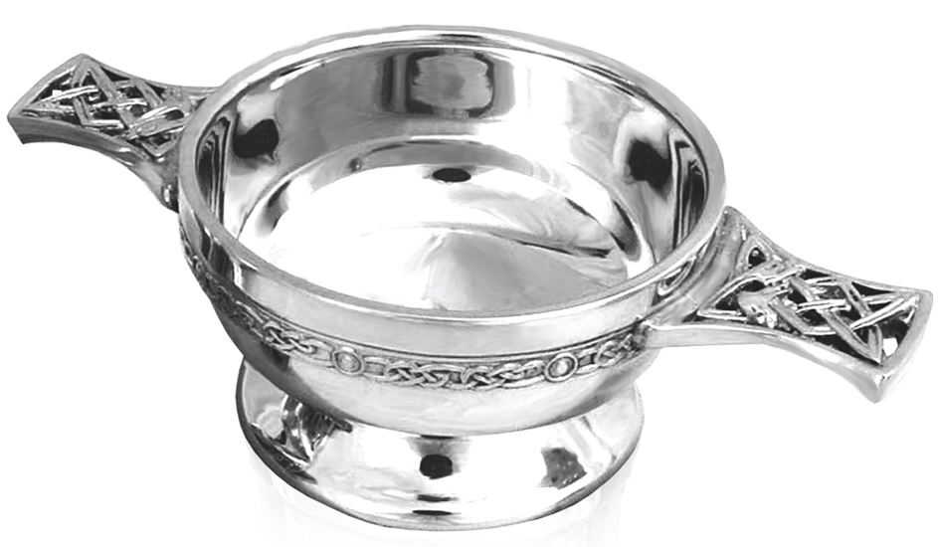
Trust is…
“The willingness of a party to be vulnerable to the actions of another party based on the expectation that the other will perform a particular action important to the trustor, irrespective of the ability to monitor or control that other party”
Myer, Davis, & Shoorman, 1995
Quaich /kwāk/

Slide 9
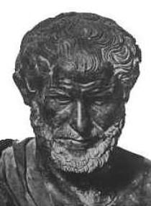
Leader Credibility & Trust
Character/integrity (Ethos)
Benevolence/caring (Pathos)
Competence
(Logos)
“People don’t care what you know until they know that you care”
Wayne Calloway, Former CEO, Pepsi Co
© 2105 Hannah Leader Development Associates

Slide 10
Two Types of Motivation
Intrinsic
Motivation
Driven by
interests, skills,
ideals,
and passions
Extrinsic
Motivation
Driven by
rewards, praise,
or recognition
Self motivated
Externally motivated
Leaders should seek to use job designs and work assignments
that maximize intrinsic motivation

Slide 11
Leader Power & Influence
Influence
&
Results
Benevolence
(pathos)
Internalization
Identification
Trust
Character (ethos)
Competence (logos)
Authority
Reward
Punish
Compliance
or
Resistance

Slide 12
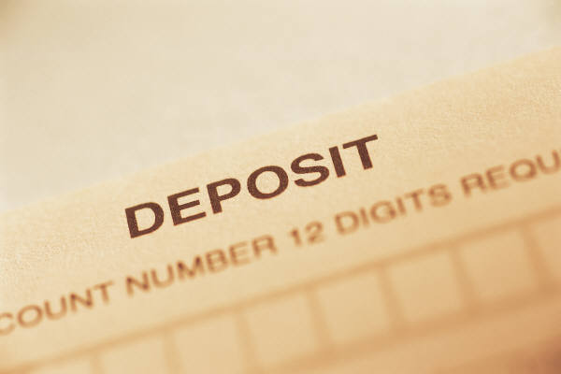
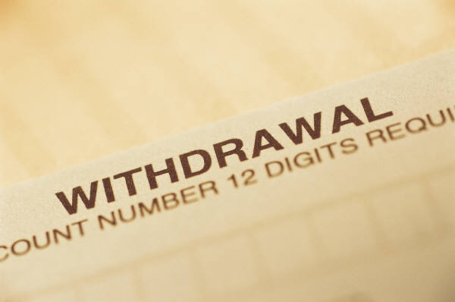
Leader
Influence
Credits
Leadership must be earned…and re-earned every day

Slide 13
Group Discussion
How can you as Captains…
Build Ethos, Logos, and Pathos?
Effectively wield power and influence?
Motivate your team members?

Slide 14
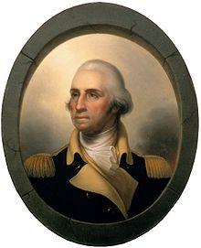
Recommended Self-Study
Leader Influence in Action
George Washington and the 1783 Newburgh Conspiracy
Free Apple iBook
https://itunes.apple.com/us/book/leading-with-character/id1085842572?mt=13

