Slide 1
Exemplary,
Inspirational
Leadership
Dr. Sean T. Hannah
Professor of management and Endowed Wilson Chair, School of Business
Wake Forest University
Colonel, US army (Ret)

Slide 2
Behavioral Indicators of
Intellectually Stimulating Leaders
Shares leadership - participative
Challenges old ways & questions status quo
Encourages followers to use imagination and divergent perspectives – even those that challenge their own
Values intellect, and thus;
Leads through giving leader intent

Slide 3

Leader Intent
What
Why
Leaders Intent
Follower
Execution
How

Slide 4
Leader’s Intent
Covers 3 Things
Purpose/Why?
Key Tasks
End State/Vision
For Key Tasks ensure you
focus on what not how
Leader’s Intent enables initiative when the situation/context changes and original plans cannot be executed

Slide 5
Behavioral Indicators of
Inspirational Leaders
Presents powerful yet attainable vision and ties that view of the future to individuals
Links individuals to the group’ history and values
Highlights the collective’s purpose over the individual’s
Role models what ‘right looks like’
Is a servant leader – versus wanting to be served
Is authentic – self aware and transparent – walks the talk
Demonstrates self-determination and commitment
Creates self-fulfilling prophecies in others

Slide 6


Resource
Services-
Washington
84% KIA
David Laychack

Slide 7
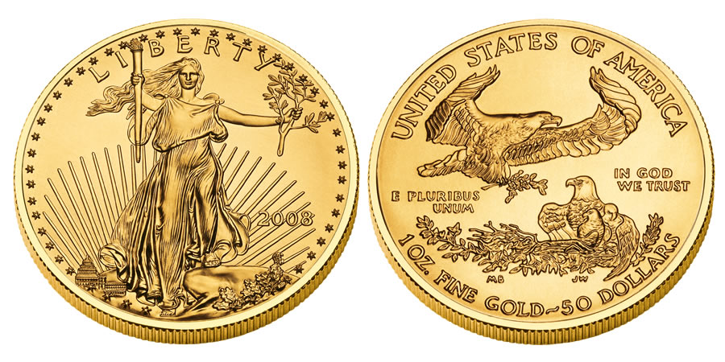
Two Sides of the Same Coin
RESPECT
VALUES
HONOR
& DUTY
We choose to honor and be dutiful to
those things that we respect & value

Slide 8
Baltimore Ravens' John Harbaugh Discusses Servant Leadership
https://www.youtube.com/watch?v=VEIDjB7uyFc

Slide 9
Francois Pienaar on Nelson Mandela – Servant Leadership
https://www.youtube.com/watch?v=8rBtis7IzF8

Slide 10
We are Marshall – Inspiration
https://www.youtube.com/watch?v=IEL8PYu4RR4

Slide 11
Friday Night Lights
Coach Gaines
on Being Perfect (2004) HD –
Inspiration
https://www.youtube.com/watch?v=o-iPiN_YHjY

Slide 12
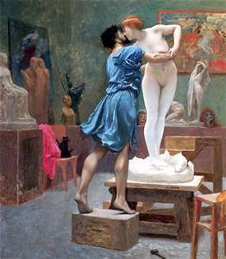
The Pygmalion Effect
High Self Expectations
Self-Fulfilling Prophesy
Success
Extra Effort/Focus
Increased Confidence
High Leader/Mentor Expectations
The sculptor Pygmalion, from Ovid's
narrative poem Metamorphoses

Slide 13
4 Components of Authentic Leadership
SELF AWARENESS
Knows who they are
Is aware of their thoughts and emotions
Understands how others see them
TRANSPARENCY
Says exactly what he or she means
Admits mistakes when made
Displays true emotions
BALANCED PROCESSING
Analyzes all data before coming to a decision
Listens carefully to different points of view before coming to conclusions
MORAL PERSPECTIVE
Makes decisions based on core values
Acts on their beliefs
Is an ethical leader

