Slide 1
Sports Leader Development Program
Coaches Session #2
CHARACTER
Dr. Sean T. Hannah
Professor of Management and Wilson Chair of Business Ethics
School of Business
Colonel, US Army (Ret)

Slide 2
Deacon Leader Development Model (26June17)
Character
Selfless
Deacon
Leader
(identity)
Competitive
Committed
Positive
Attitude

Slide 3
Agenda
Values, morals and ethics – making (and helping players make) tough ethical decisions
Role modelling as a coach through personal example and ethical leadership
Building honor, duty, and professional identity in players

Slide 4
Values, Morals, & Ethics
The principles, standards, and/or qualities considered important, worthwhile, or desirable “What do I value?”
Values
Morals
Ethics
The goodness or badness
of human action and character
“What is right or wrong”
The system or theory of applying moral values
“How do I put my morals & values into action?”
Copyright ©
TLDG 2016

Slide 5

Leaders as Teachers - 3 “Ethical Lenses”
What are the rules, laws, duties, norms, etc.
that apply to the dilemma and possible courses
of action (COA)? Whose rights are at stake? (Thomas Jefferson- Deontology)
RULES/
RIGHTS
What are the outcomes likely from the various COAs? Which is the most acceptable, benefits
the most, harms the least? (John Stuart Mill - Teleology)
OUTCOMES/
CONSEQUENCES
How well do the various COA’s align with your personal values and beliefs? (Aristotle - Areteology)
VIRTUES/
INTEGRITY
Copyright ©
TLDG 2016
Notes:
We call the three perspectives described by FM 6-22 “Ethical Lenses”.
Rules are those specifications that a group or groups agree to follow – laws, treaties, professional ethic, etc.
Outcomes are the foreseeable results of action/behavior.
Virtues are those components of “moral and good” human beings that transcend most cultural differences between civilized societies. Many Ethicists consider virtues to be the basis for other constructs like values and morals. Many times all these terms are used interchangeably.
We peer through various lenses to address the different aspects of a event or problem.
In general because of the way our brains work, we tend to solve problems in ways that are quick and/or have worked for us before.
We may not always look for a rule/regulation/professional norm that defines the solution, or consider the factors to produce the best outcome, or compare our personal virtues learning from similar situations.
Note that it is important to “look” through all these lenses to ensure all aspects in the Ethical Situation are considered.
Leaders use multiple perspectives to think about ethical conflicts, applying all three perspectives to determine the most ethical solution.
Applying all three Ethical lenses considering virtue, rules, and outcomes to each Course of Action is called “Ethical Reasoning”.

Slide 6
What Right vs. Right Situations Have You Faced in Coaching?
How did you come to and communicate the resolution?

Slide 7
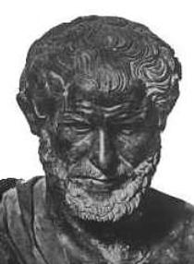
Role Modelling & Leader Credibility
Character/integrity (Ethos)
Benevolence/caring (Pathos)
Competence
(Logos)
Copyright ©
TLDG 2016

Slide 8

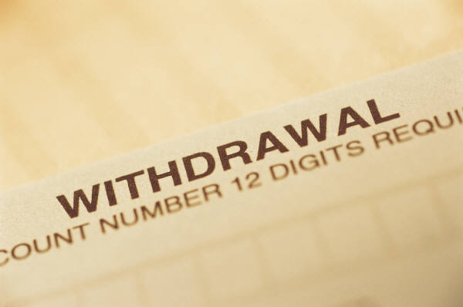
Leader
Influence
Credits
Leadership must be earned…and re-earned every day

Slide 9
Dual Approaches To Ethical Leadership
Transactional:
Systems, policies, rules, standards
Monitoring systems
Accountability: Reward exemplary
behavior & punish violations
Transformational:
Role model ethos, logos, pathos
Promote ethical voice
Reinforce professional identity
Build respect and values
Make ethics part of ongoing narrative & messages
Compliance focused – Avoid wrongdoing
Moral aspiration focused – Seek right-doing
Copyright ©
TLDG 2016

Slide 10
What new things can you do as coaches to reinforce your credibility and be more transformational as
ethical leaders?

Slide 11
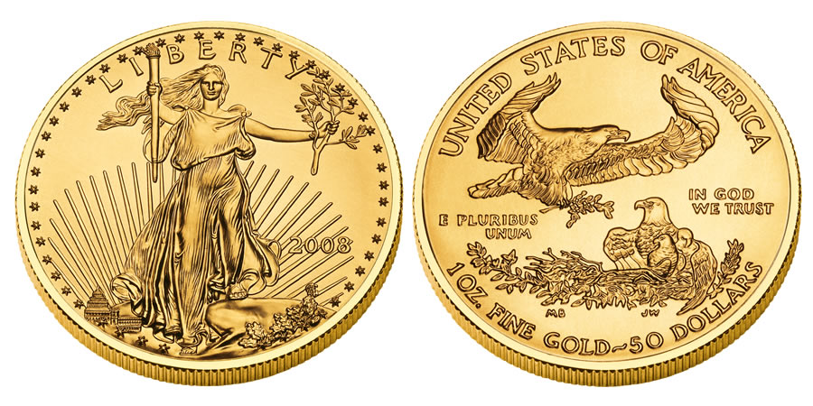
Driving Honor & Duty in the Team
RESPECT
VALUES
HONOR
& DUTY
We choose to honor and be dutiful to
those things that we respect & value
Copyright ©
TLDG 2016

Slide 12
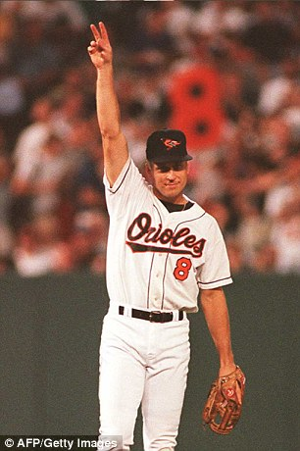
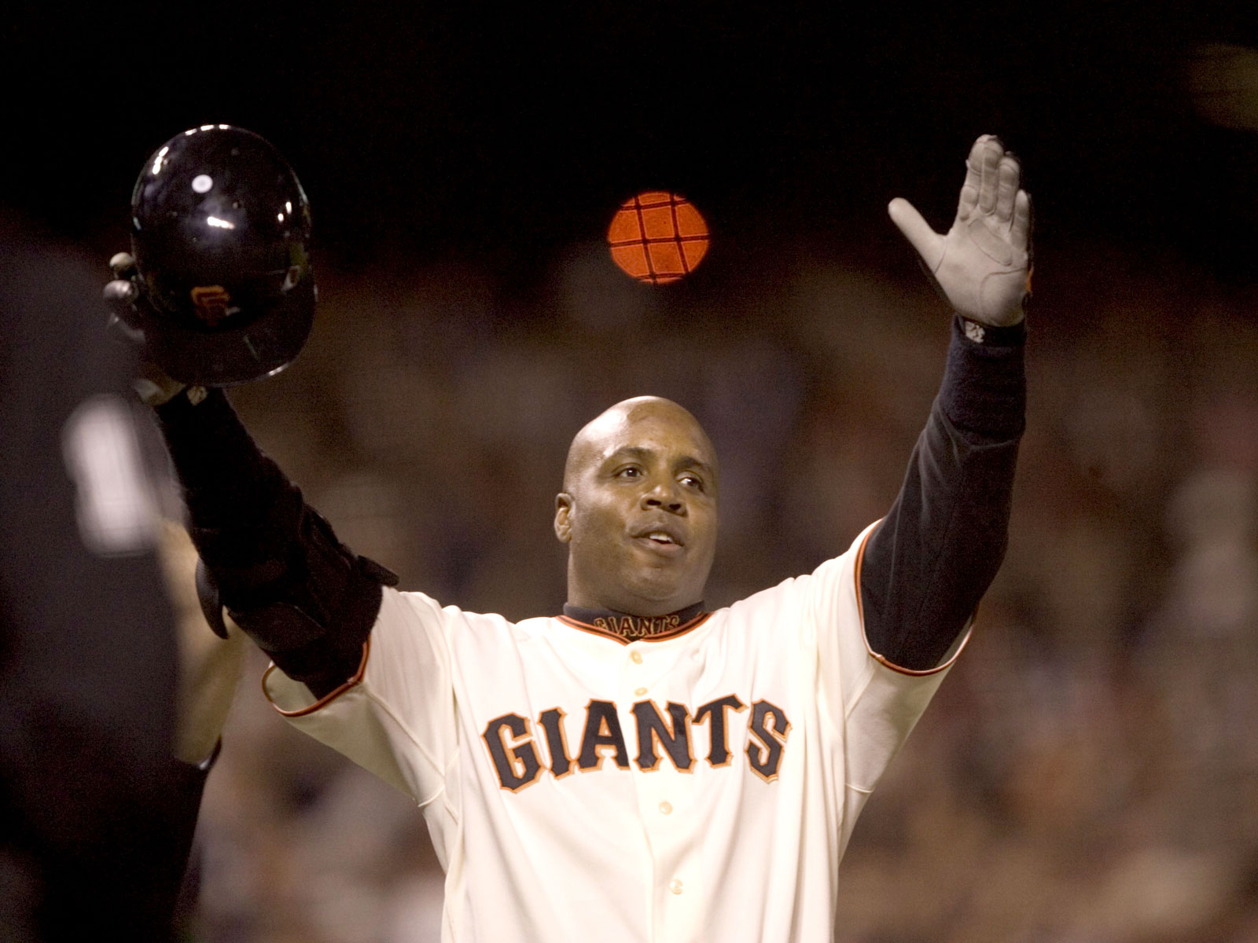
Professional Identity
How do Barry and Cal differ?

Slide 13
What new things can you do as coaches to build stronger respect, values, and professional identity in players?

Slide 14
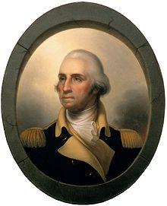
Recommended
Self-Study
Leader Character and Influence in Action
George Washington and the 1783 Newburgh Conspiracy
Free Apple iBook
https://itunes.apple.com/us/book/leading-with-character/id1085842572?mt=13

Slide 15
Take-Aways
Teach players how to operationalize their and the team’s values into ethical codes
Teach players the ethical lenses and use to enrich their moral complexity
Create a deliberate plan to demonstrate ethos, logos, and pathos
Create a deliberate plan to transform the ethics of your players and the team
  Respect and values
  Culture of discussing ethics
  Professional identity

